Slide 1
Centralized Application-Context Aware Firewall
CSE7101- Capstone Project
Review-2
Batch Number: IST_33
Under the Supervision of,
Dr. Poornima S
Assistant Professor
School of Computer Science and Engineering
Presidency University
Roll Number | Student Name
20221IST0109 20221IST0100 20221IST0114 | SANJANA K HARINI K HEGDE SNEHA S
Name of the Program: Information Science and Technology
Name of the HoD: Dr. Pallavi R
Name of the Program Project Coordinator: Ms. Benitha Christinal J , Assistant Professor(SoCSE)
Name of the School Project Coordinators: Dr. Sampath A K , Dr. Geetha A
Name of the examiner 1: Ms. Neha Seirah Biju
Name of the examiner 2: Ms. Babitha S

Slide 2
Problem Statement Number: PSCS_365
Problem Description:
Traditional firewalls operate at the network or packet level and lack visibility into which application or process initiates a connection.
They fail to answer:
Which process opened this port?
Is this connection normal for this application?
Are there anomalies in traffic behavior?
Enterprises require real-time, centralized, application-aware monitoring with ML-based anomaly detection to prevent unknown threats..

Slide 3
Content.
Abstract
Literature survey
objectives
Existing methods and drawbacks
Innovation or Novel Contributions
Proposed method and feasibility study
Architecture Diagram
Modules
Hardware and software detail
Timeline
References

Slide 4
Abstract
This project implements a Centralized Application-Aware Firewall designed to monitor endpoint systems, analyze real-time network activity, and detect anomalies using machine learning. A lightweight endpoint agent continuously captures process-level network connections and forwards them to a FastAPI-based central server. The backend performs context-aware analysis, applies an Isolation Forest anomaly model, and streams events live to a React-based dashboard via WebSockets.
The system improves enterprise security by providing process–connection visibility, centralized monitoring, and AI-driven threat scoring with minimal endpoint overhead.

Slide 5
Literature survey
AI-Driven Dynamic Firewall Optimization Using Reinforcement Learning for Anomaly Detection and Prevention
Adaptive Cybersecurity: Dynamically Retrainable Firewalls for Real-Time Network Protection
Analysis of Web Application Firewalls, Challenges, and Research Opportunities
Web application firewall based on machine learning models
Beyond Firewall: Leveraging Machine Learning for Real-Time Insider Threats Identification and User Profiling
Dynamic AI-Augmented Firewall for Real-Time Threat Mitigation
Centralized Application-Context Aware Firewall
A Comprehensive Survey of ML-Based WAFs with Signature and Anomaly Detection
AI Based Anomaly Detection in Endpoint Logs
Machine Learning and AI in Endpoint Security: Analyzing Use of AI/ML Algorithms for Anomaly Detection and Threat Prediction in Endpoint Security

Slide 6
Objectives.
To design an agent that monitors process-level network activity.
To collect and centralize endpoint events for real-time analysis.
To detect anomalies using a trained Isolation Forest model.
To visualize live events on a web dashboard with alerts.
To provide a foundation for automated policy enforcement.
To build a scalable, modular, cross-platform security system.

Slide 7
Existing Methods and Drawbacks
Relies on traditional packet-based firewalls.
Lacks process-level visibility.
No ML-driven anomaly scoring.
Logs stored locally, not centralized.
No real-time live monitoring dashboard.
Limitations: Manual, slow, isolated, and lacks intelligent decision-making.

Slide 8
Proposed Method and Feasibility study
The proposed system introduces:
Endpoint Agent → captures active TCP connections + process path.
Central Server → receives events, scores anomalies, broadcasts alerts.
ML Engine → Isolation Forest for unusual traffic detection.
Admin Dashboard → real-time live event visualization.
This enables context-aware, intelligent, centralized firewall monitoring.

Slide 9
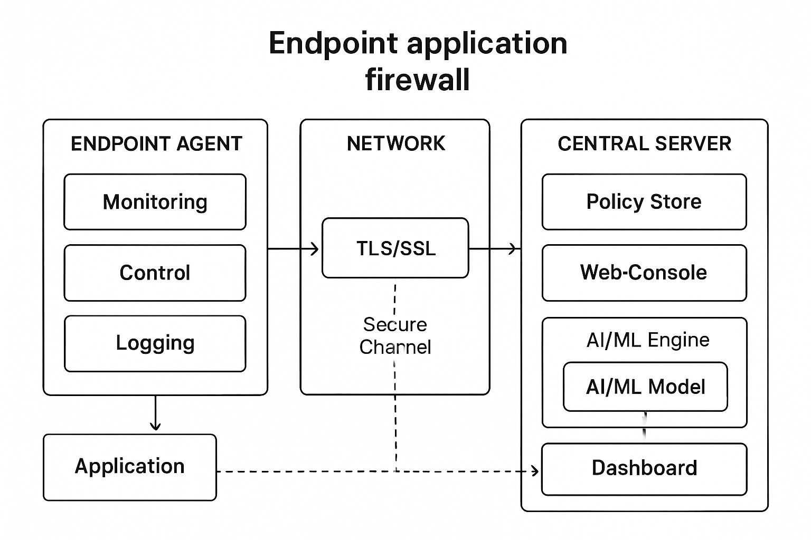
Architecture
Flow:
Endpoint agent collects process–connection metadata
Sends events → Central FastAPI server
AI module scores anomalies
Alerts broadcast via WebSockets
Admin dashboard displays live events
Policies can be enforced (future stage)

Slide 10
Hardware and Software detail
The endpoint requires a basic dual-core CPU, 2–4 GB RAM, Windows 10/11, and Python to run the monitoring agent.
The central server needs a 4–8 core CPU, 8–16 GB RAM, and SSD storage to host the backend and dashboards.
The system uses Python (FastAPI, psutil, scikit-learn), Node.js (React dashboard), and WebSockets for real-time communication.
A stable LAN/internet connection, browser support, and tools like Git and VS Code are required for development and deployment.
Overall, the setup supports lightweight endpoint monitoring and centralized AI-based anomaly detection.

Slide 11
References (IEEE Paper format)
[1] K. Singh and S. Silakari, “A survey of cyber-attack detection systems using machine learning,” International Journal of Computer Applications, vol. 45, no. 17, pp. 25–32, May 2021.
[2] Palo Alto Networks, “Next-Generation Firewall (NGFW) Overview,” Palo Alto Networks, 2023. [Online]. Available: https://www.paloaltonetworks.com/network-security
[3] Z. Noor, S. Hina, F. Hayat, and G. A. Shah, “An intelligent context-aware threat detection and response model for smart cyber-physical systems,” Internet of Things, vol. 23, p. 100843, 2023.
[4] Noor, Z. et al. "An intelligent context-aware threat detection and response system." (2023). ScienceDirect (Cites IEEE approaches in system design and implementation for context-aware security, likely relevant for architecture, although direct IEEE publication or citation may be needed)
[5]A. Rathore, N. Chaudhary, K. Jangid, N. Hooda, and S. Sharma, "Centralized Application-Context Aware Firewall," Pratibodh, vol. 12, no. 2, pp. 15–24, Jun. 2025.
[6]P. Mandru, "Machine Learning-Based Anomaly Detection in NFV: Security Challenges," Computers, Materials & Continua, vol. 77, no. 2, pp. 1751–1768, Jun. 2023.
[7]Z. Liu, L. Sun, B. Chen, and T. Li, "Deep Learning-based Anomaly Detection and Log Analysis for Computer Networks," Journal of Information and Computing, vol. 2, no. 2, pp. 34–63, 2024.

Slide 12
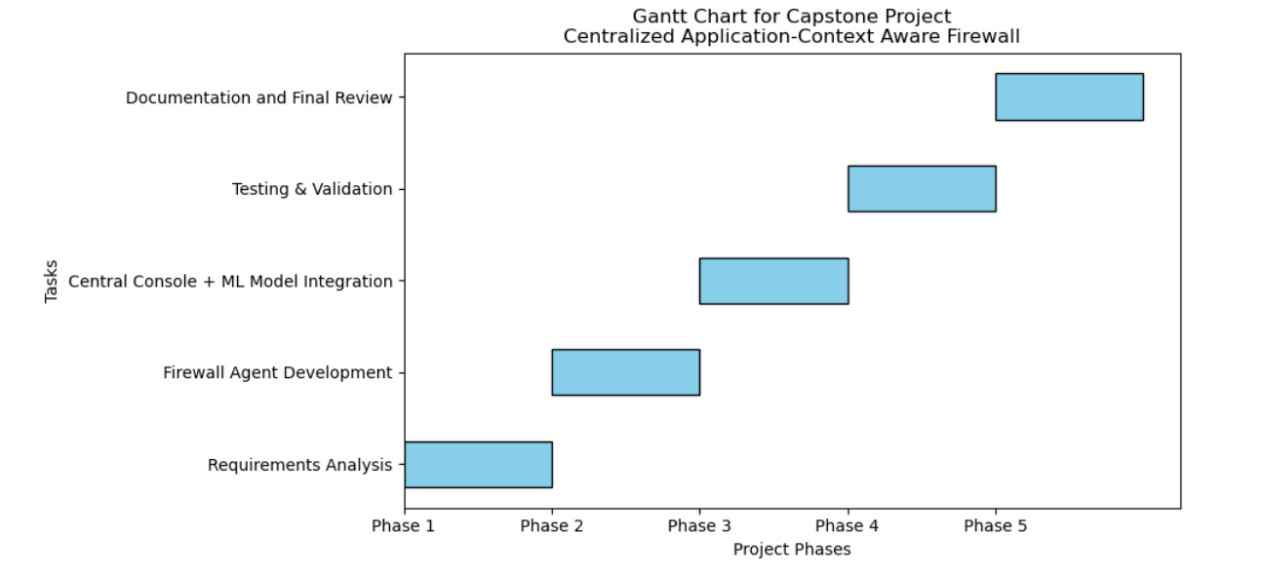
Timeline of the Project (Gantt Chart)

Slide 13


